Slide 1
KNOWLEDGE SHARING ON TRADE AND INVESTMENT “GOOD PRACTICES”
This project is co-funded by
the European Union
and the ACP secretariat
Venue:ACP Secretariat
6 February 2020

Slide 2
The Port Single Window Many definitions but one concept
What is it?
What is its function
What are the benefits
A tool allowing public and private parties involved in trade and transport to transmit information with single entry point
A tool allowing parties to share information to optimize operations
A tool that has specificities linked to maritime trade and port activities
Common environment for exchange of information among actors of the supply chain
Facilitation of transactions and electronic monitoring of the administrative processes
Improved monitoring of cargo handling and port work by authorities and private actors
Enabling electronic payments
Simplification of procedures
Improved Efficiency and optimisation of Operation
Reduced dwell time for cargo
Cost reduction for both private actors and public institutions
Increased Customs revenues
Increased Transparency

Slide 3
The Port Single Window The Actors of the port….
Public Actors
Private Actors
Port Administration/Management
Customs Administrations
Health/Fitosanitary/Veterinary
Immigration
All actors of PCS, ISPS etc…
Terminal Operators*
Ship Crews
Stevedore
Pilot
Tug
Freight forwarder
Shippers
Shipping lines and agents
Ship repair
Terminal operators*
The National and International Actors….
Integration within a national Single Window for external Commerce
Integration with regional systems for information exchange

Slide 4
The FAL Convention
The International Maritime Organization (IMO) has set mandatory requirements (valid since April 2019) in regard to electronic exchange of information on cargo, crew and passengers within the Convention on Facilitation of International Maritime Traffic (FAL). The IMO recommends the implementation of the “single window” concept. It also ahs implemented a project to develop a “Model” Port Single Window for the use of developing countries

Slide 5
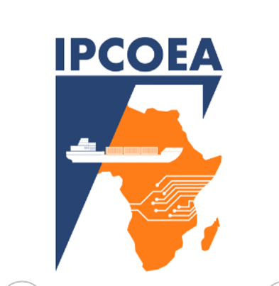
Outline of the project
Development and implementation of a Capacity Building Programme on the «Port Single Window», including:
Development of a medium term training programme, lasting 7 weeks and taking place in Abidjan for 15-20 people
(1 person from Port Management and 1 person from Port Customs administration from 7 countries, 2 persons from ECOWAS, 4 persons from ARSTM teachers) on the concept of Port single window
Development and implementation of 7 training sessions in the 7 target ports
Implementation of a Grant Scheme to support small-scale actions to start-up or further develop the process for implementation of «Port Single Windows»
Development of a toolkit for decision makers to support implementation of port single windows
Set-up of networking and regional cooperation arrangements:
Network of Institutions
Network of professionals

Slide 6
Objective:
Capacity Building
Direct Support to Ports
Practical Tools and Networks
Targeted Outputs
15-10 Professionals trained with intensive training
100 professionals targeted by short-term training
7 Implemented Pilot Actions
7 ports supported in developing planning for MSW Implementation
1 Tookit
1 knowledge repository
1 network of institutions
1 network of professionals
improve efficiency of customs and administrative clearance process of port operations in accordance with EPAs in Ports of the ECOWAS Area through the implementation of Single Window Systems

Slide 7
Benefits of the IPCOEA Project for Target Organisations
Training to Personnel
3
1
2
Direct support to own planning and development
Access to tools and networks

Slide 8
«Necessary» Practices
Involve all relevant stakeholders but…
…take adequate institutional steps
Consider the limits and benefits of a regional approach
Contact regional actors
Build on what already exists

Slide 9
The Way Forward
Cooperative fora and development of the Capacity Building
Development of Short-term Training
& Launch of the Grant Scheme
Finalisation of project Training
Project Closure
JUN
JUL
AUG
SEP
OCT
NOV
DEC
JAN
FEB
MAR
APR
MAY
JUN
JUL
AUG
SEP
OCT
NOV
DEC
JAN
FEB
MAR
APR
MAY
JUN
JUL
AUG
SEP
2019
2020
2021
Project Start
Completion of Pilot Actions and finalisation of outputs
Realisation of a Study and set-up of project structure
Implementation of the Mid-term Training
Implementation of the Grant Scheme & Development of the Toolkit

Slide 10
Limits of the Technical Assistance
The regional approach needs to concretise in local actions
Limited budget in single projects
Trade support organisations must be enabled by local stakeholders to deliver their support
The wide variety of stakeholders requires a high-level institutional coordination
Political decisions may render support less feasible

Slide 11
Further support
Cordination with other projects.
Assure inclusion of single window approach in port reform projects supported by the EU
Integrate trade facilitation in other actions related to maritime sector reform
Support national actions with technical assistance and grants
Valorise the role of regional organisations

Slide 12
thanks for your attention
Marco Simoncini
+39 3491320350
Simoncini.m@imssea.org

